Slide 1
Project1 (MyProject) Creation Steps
Submitted By : Nilesh Shardul
Email : nileshbshardul@gmail.com

Slide 2
Following are the Major steps
Network setup (VPC, Subnet, Internet Gateway, Route tables)
RDS – MySQL DB (Subnet group, DB setup and configure)
EC2 instance creation (Configure MySQL in Security Group)
Configure RDS Security Group to EC2 Security Group
Login to EC2 and test DB from MYSQL client, create tables
Create new AMI and test creating new instances with the new AMI
Create Load Balancer for EC2 (Load Balancer, Target Group)
Create Auto Scaling for EC2 (Auto Scaling Group, Launch Configuration)

Slide 3
A. Network setup (VPC, Subnet, Internet Gateway, Route tables)
In this, new VPC is created for MyProject and two public subnets are created in AZ us-east-1a and us-east-1b. New internet Gateway is created and attached to VPC. In the route table created for VPC, inbound traffic from internet is linked to internet Gateway.
Following are the steps (with screenshots to achieve this)

Slide 4
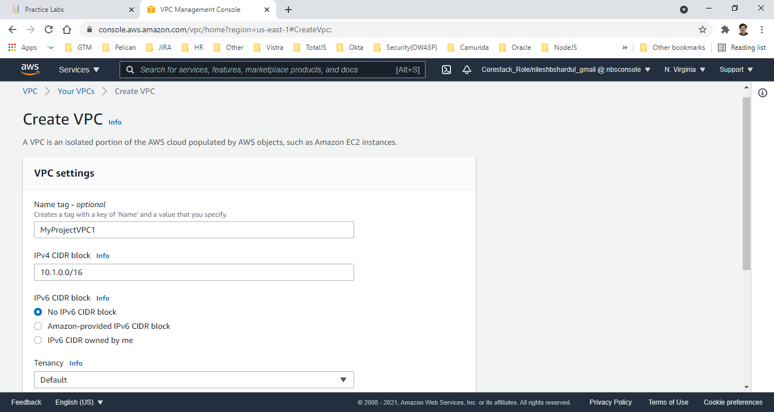
Step 1 : New VPC created for my project -MyProjectVPC1

Slide 5
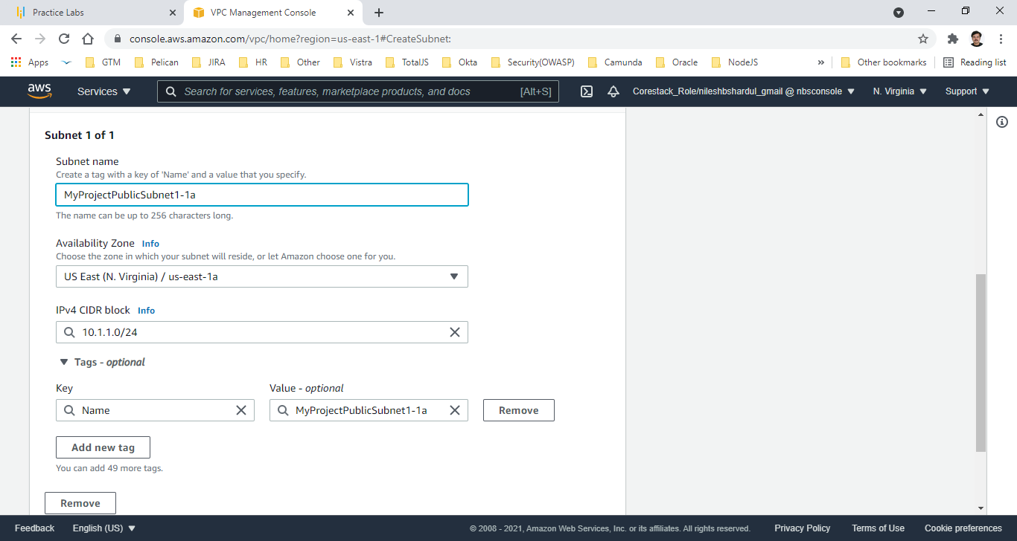
Step 2: Public subnet MyProjectPublicSubnet1-1a created for my VPC in AZ us-east-1a with CIDR block 10.1.1.0/24

Slide 6
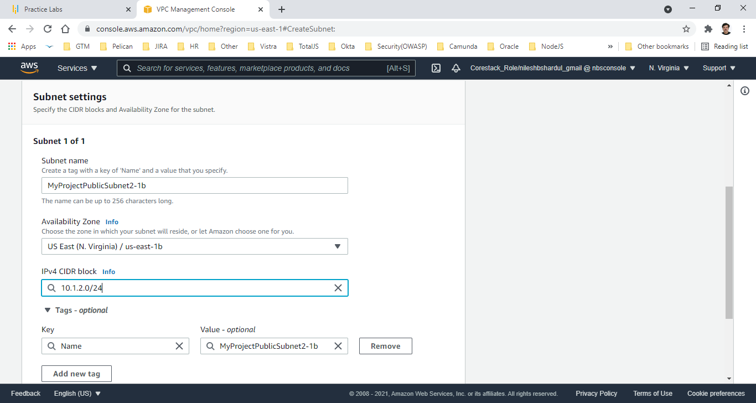
Step 3: Public subnet MyProjectPublicSubnet2-1b created for my VPC in AZ us-east-1b with CIDR block 10.1.2.0/24

Slide 7
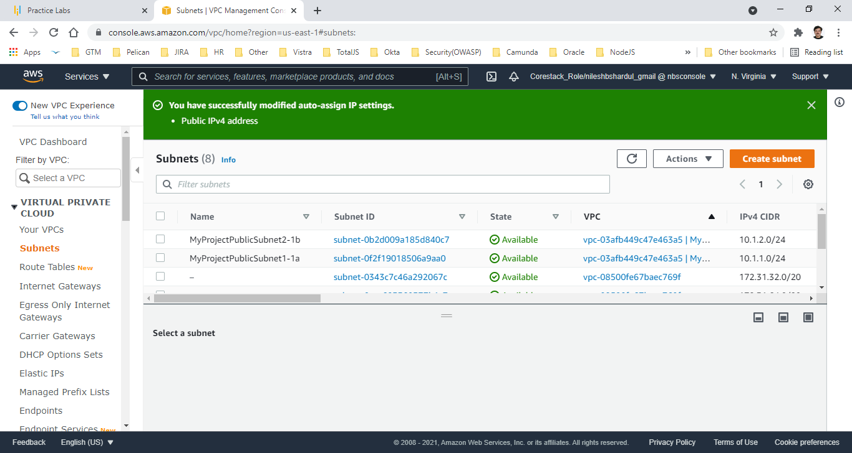
Step 4: Verify the subnets created for the VPC

Slide 8
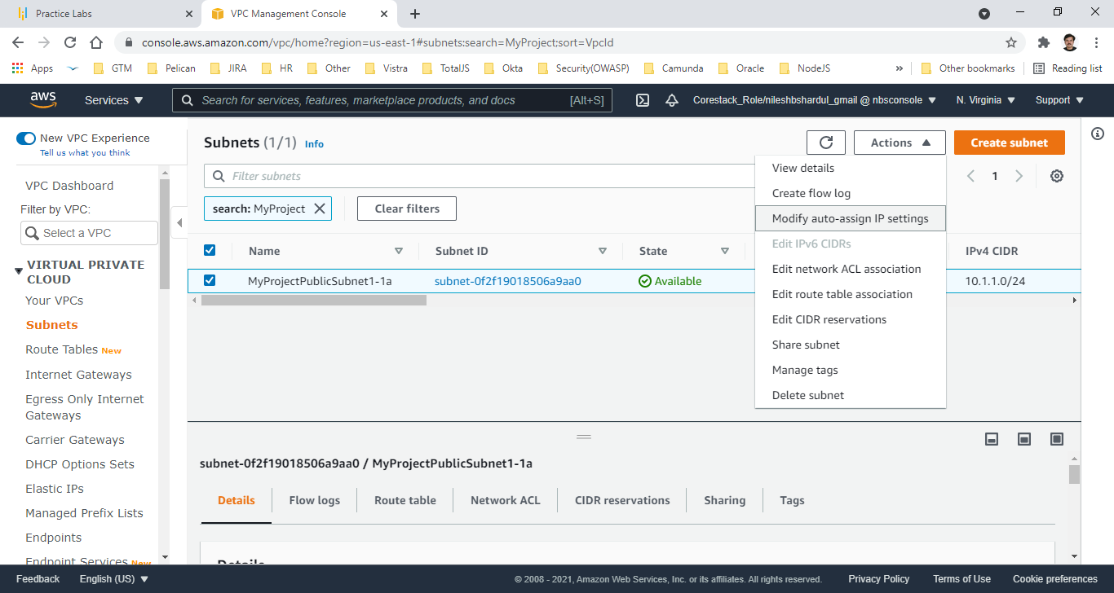
Step 5: Modify all new public subnets to auto assign public IP address

Slide 9
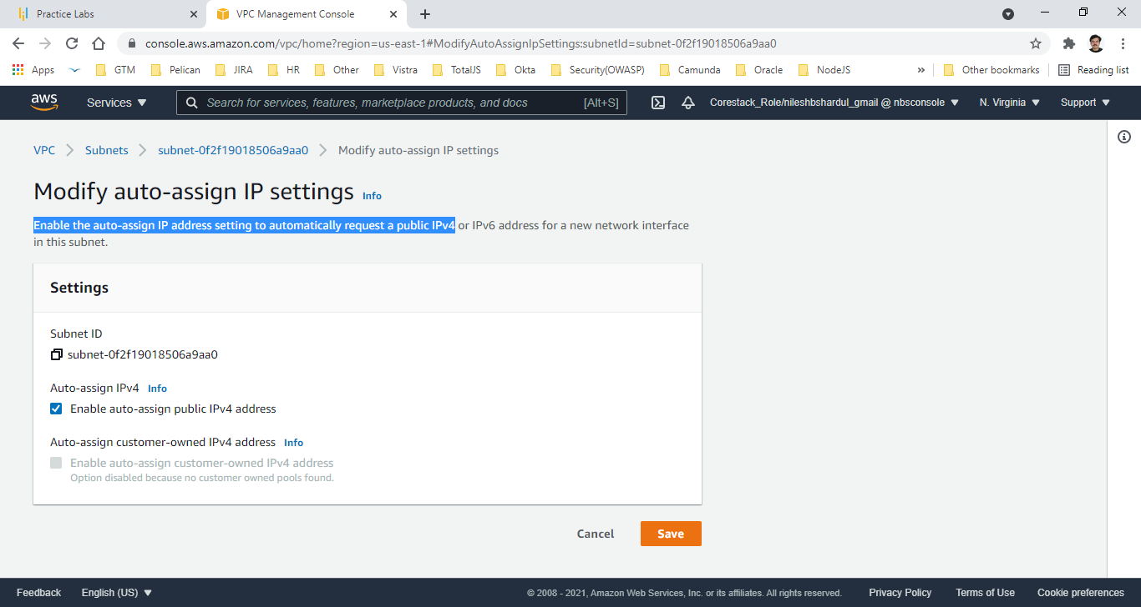
Step 6: Enable auto-assign public IPv4 address for all subnets

Slide 10
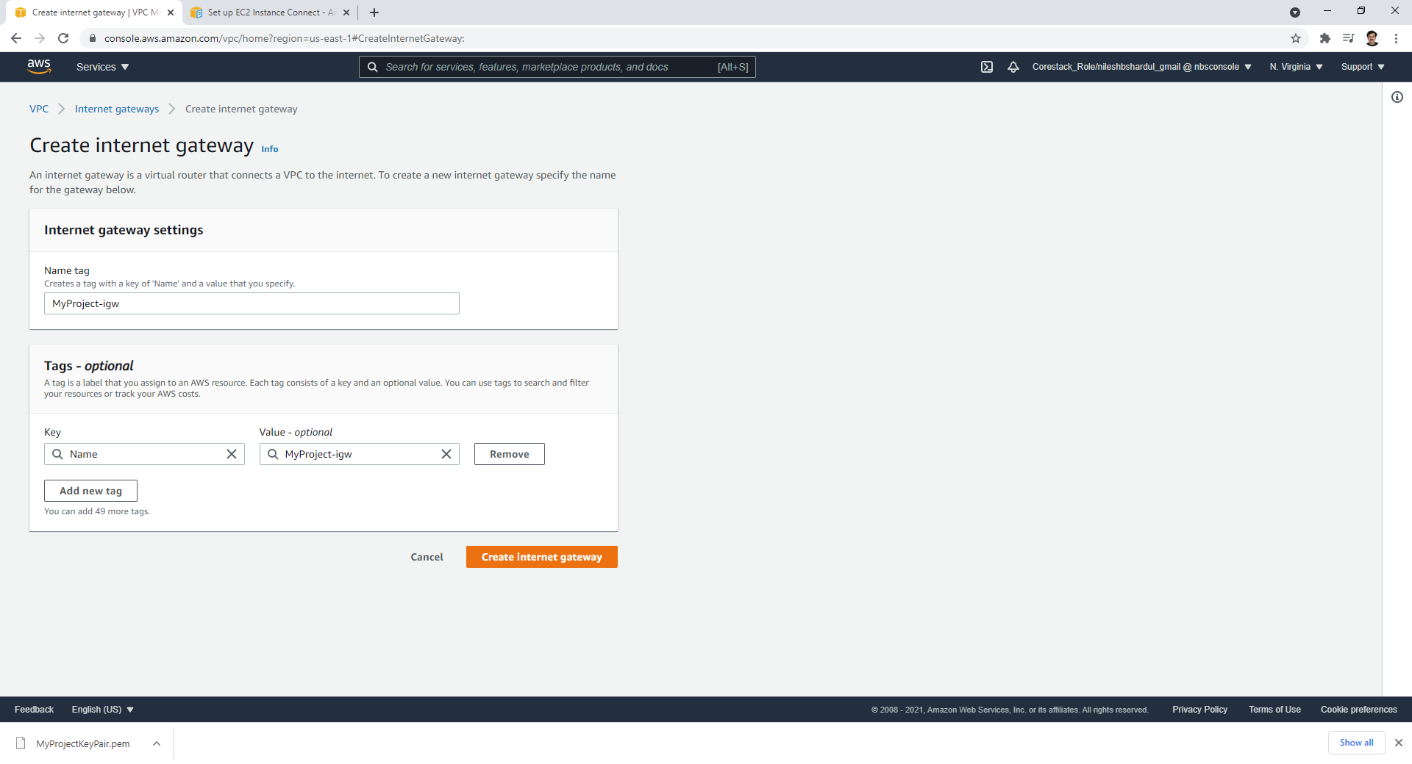
Step 7 : Create new Internet Gateway MyProject-igw

Slide 11
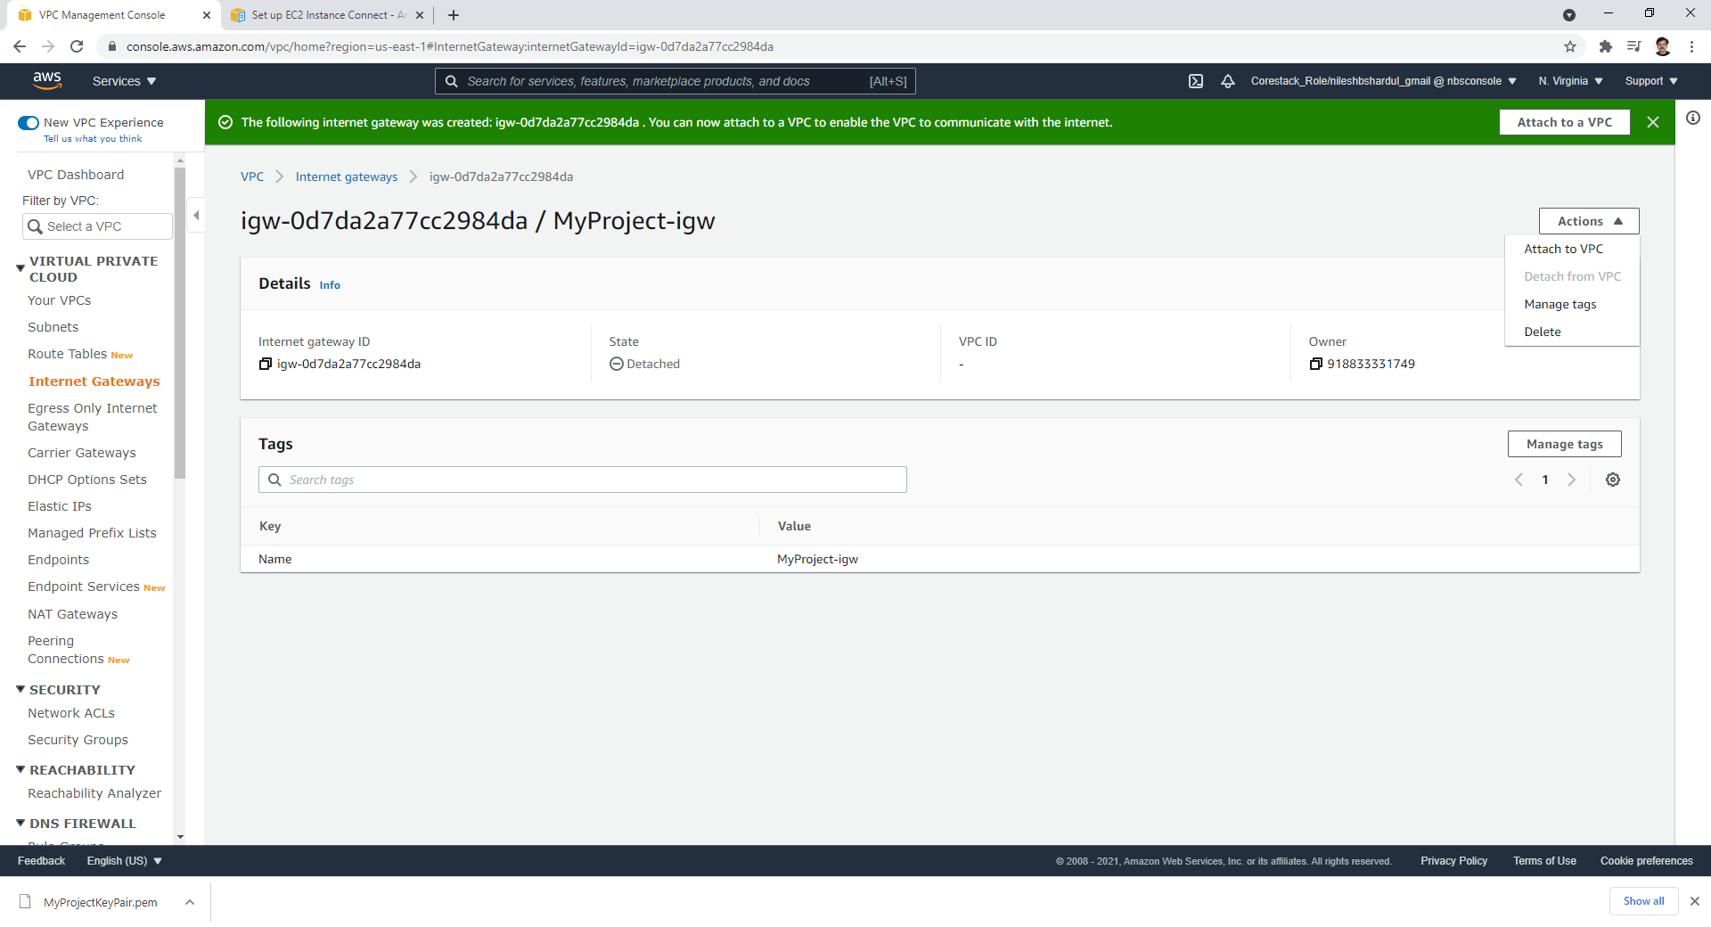
Step 8: Select Internet Gateway and click on Attach to a VPC

Slide 12
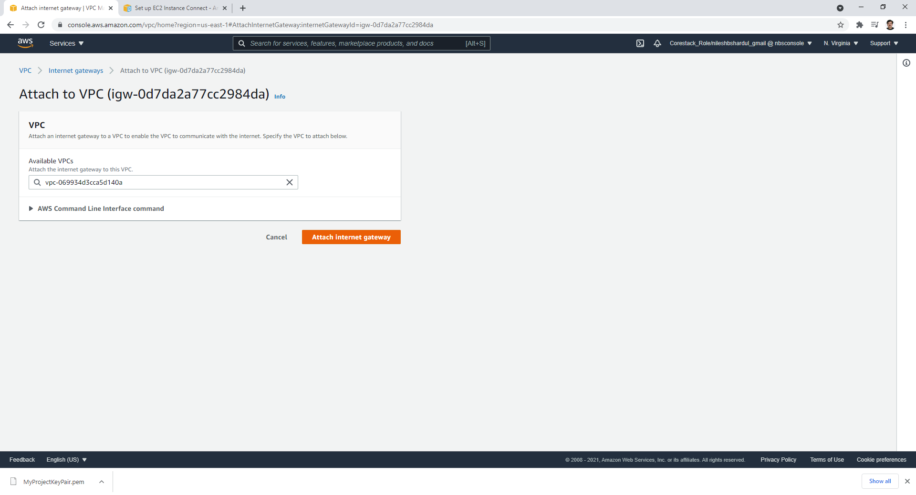
Step 9: Attach gateway to the MyProject VPC

Slide 13
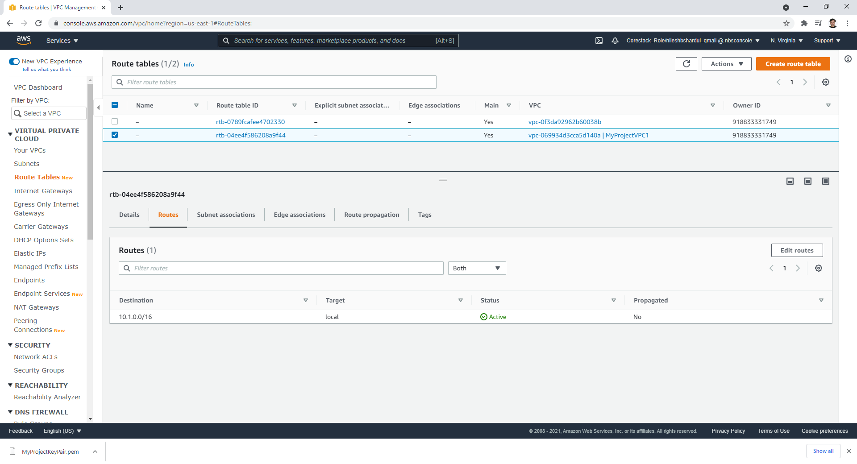
Step 10: Check Route table created for MyProject VPC and click on Edit routes

Slide 14
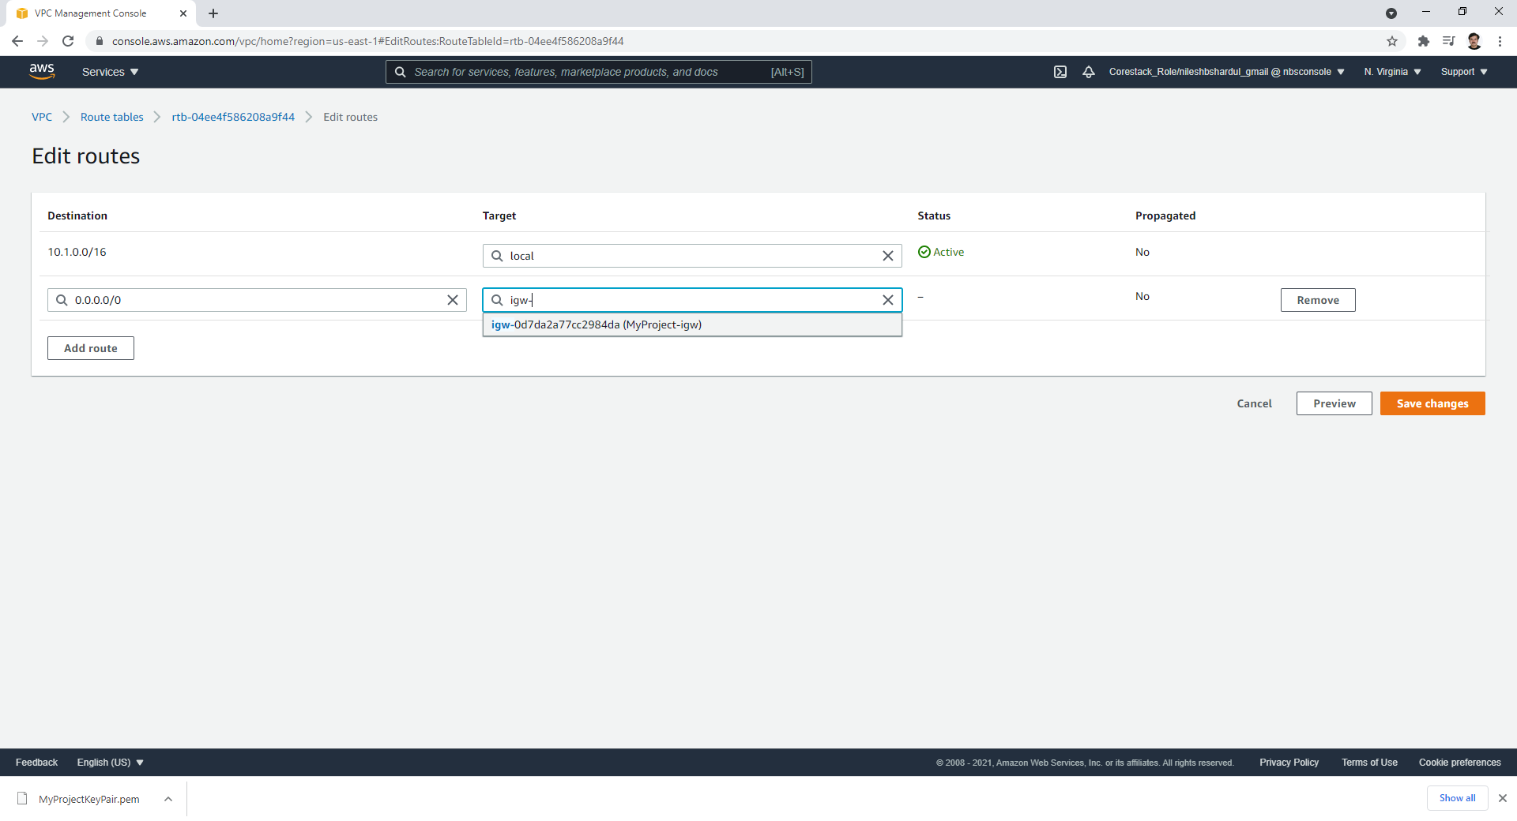
Step 11: Add new route, for destination 0.0.0.0/0 (internet) add our new internet gateway MyProject-igw as target

Slide 15
B. RDS – MySQL DB (Subnet group, DB setup and configure)
In this, first create subnet group and attach VPC and its subnets. Then create MySQL RDS with standard, free-tier instance setup with auto-scaling, backup and minor version upgrade enabled.
This DB should be created to VPC and the new subnet group created for the VPC.
Please refer following steps with screenshots.

Slide 16
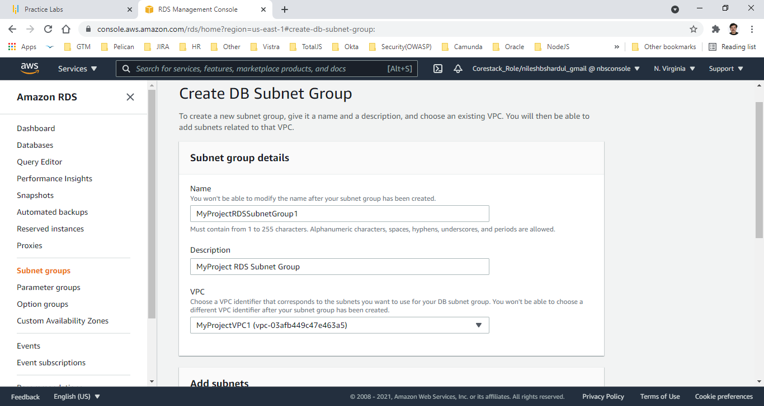
Step 1: Create New Subnet Group MyProjectRDSSubnetGroup1 in MyProject VPC

Slide 17
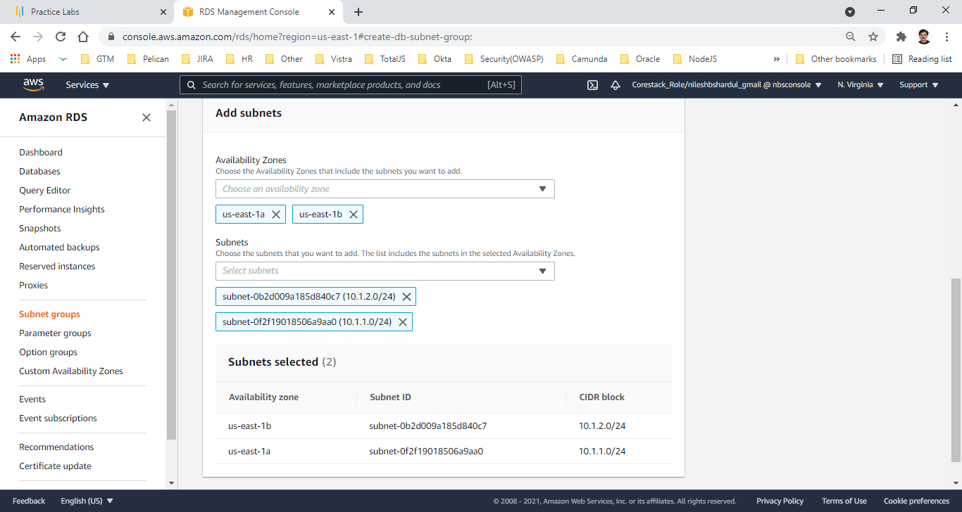
Step 2: Add subnets to your subnet group

Slide 18
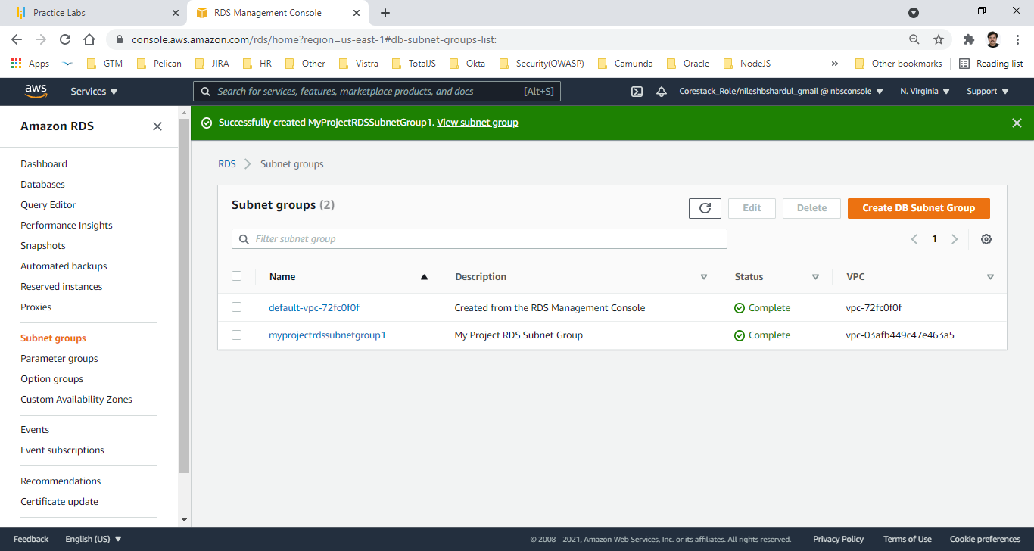
Step 3: New RDS Subnet group created for my VPC

Slide 19
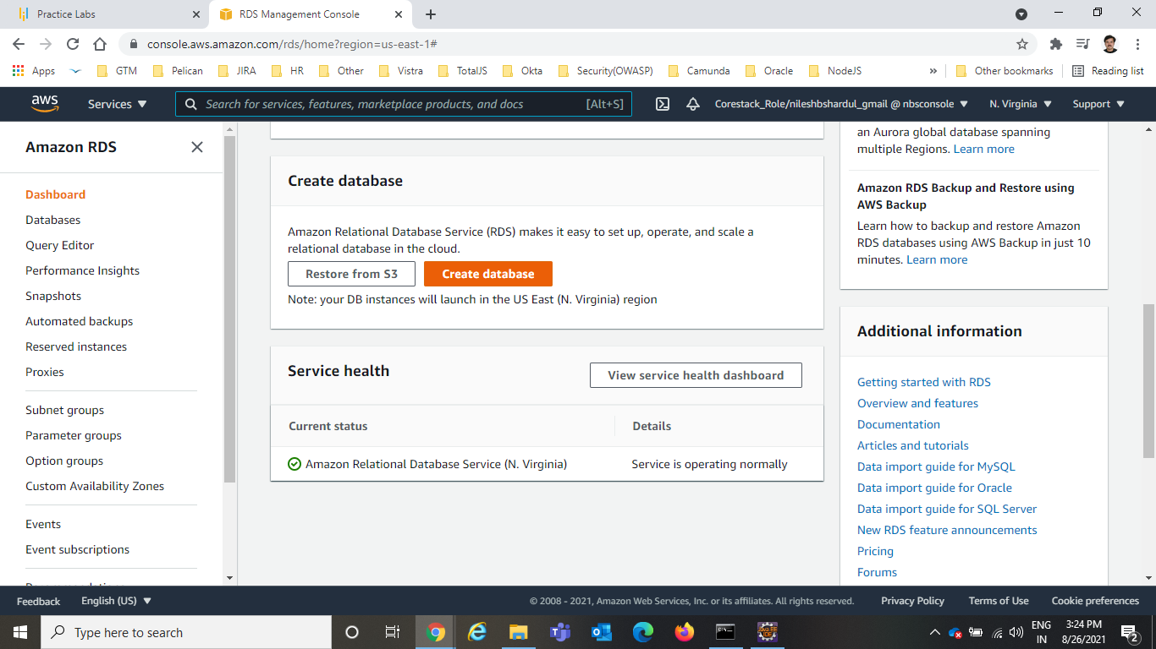
Step 4: Go to RDS service

Slide 20
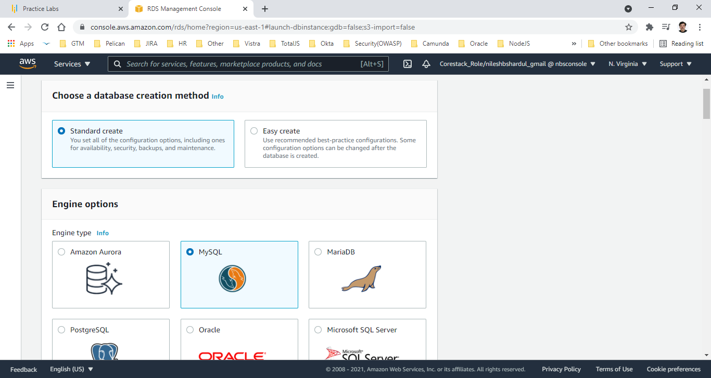
Step 5: Click on Create Database , select Standard create and MySQL options shown below

Slide 21
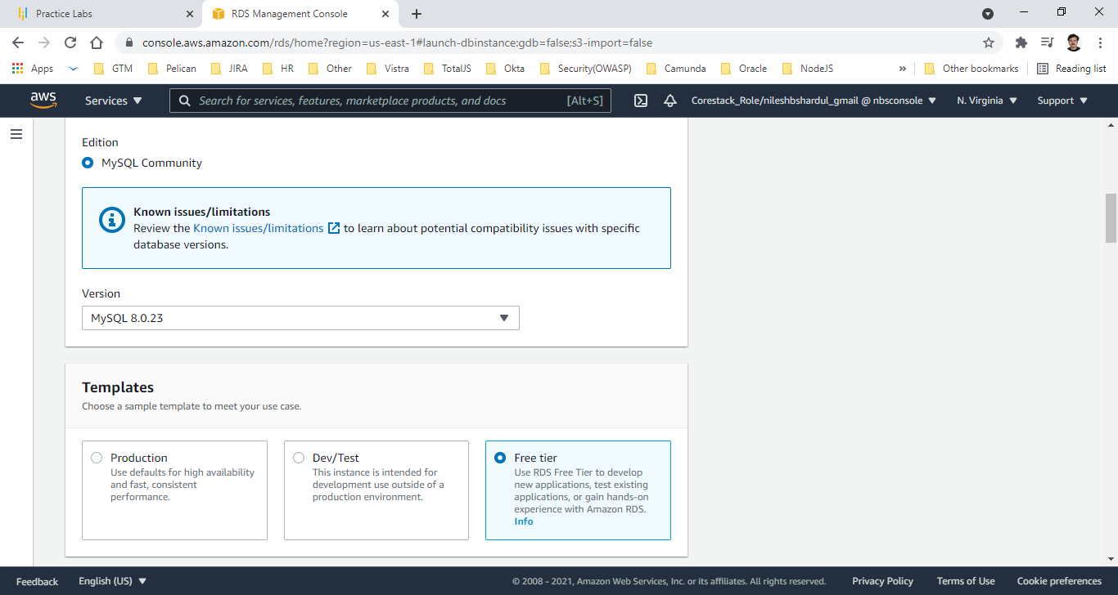
Step 6: Select version and free tier option shown below

Slide 22
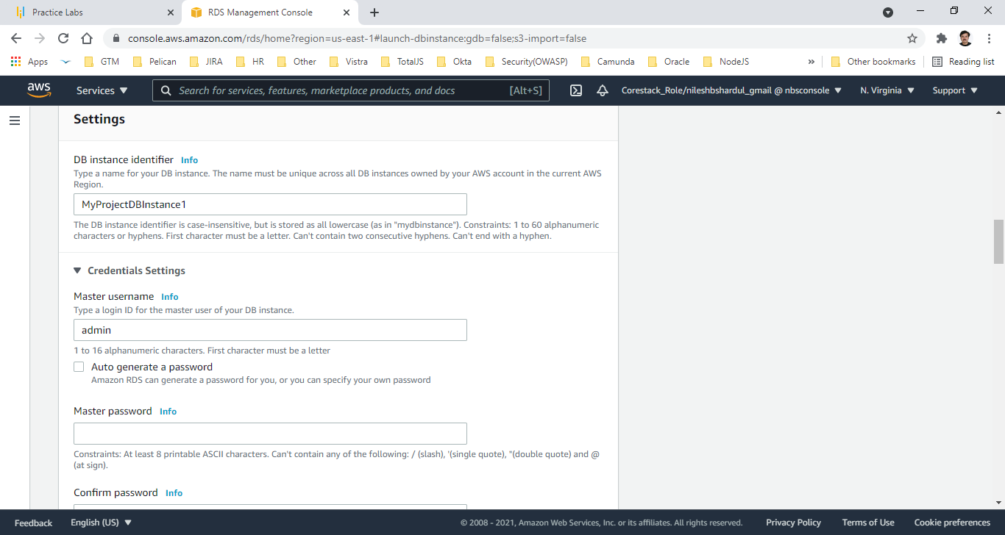
Step 7: Give DB instance name MyProjectDBInstance1

Slide 23
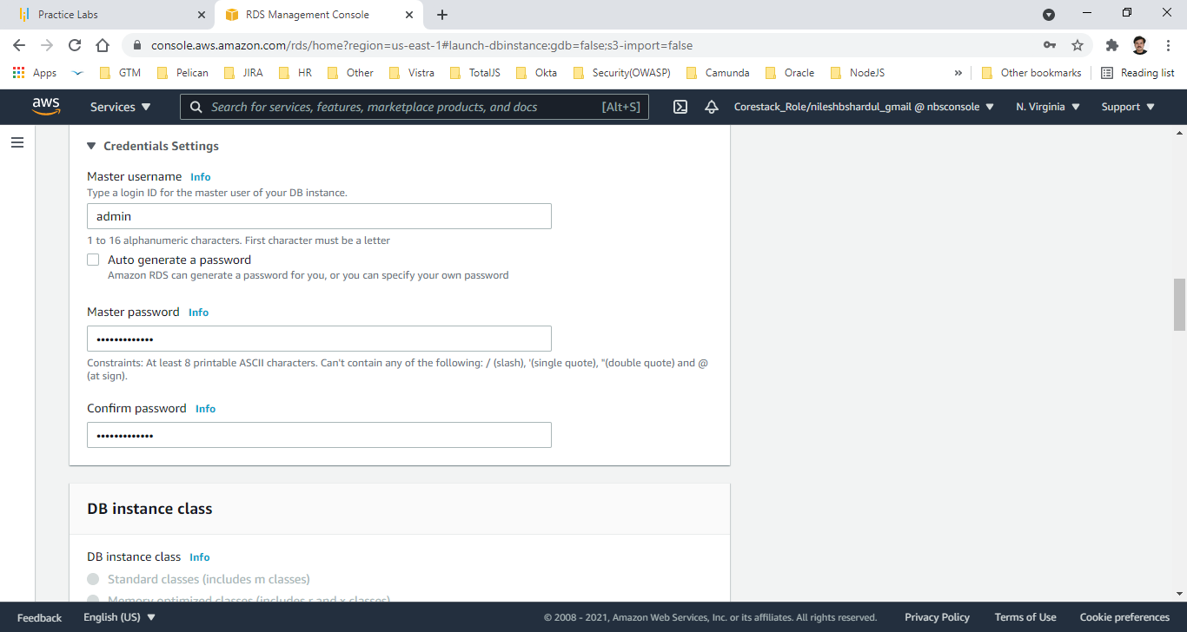
Step 8: Provide credentials for Master user (Master username and Password)

Slide 24
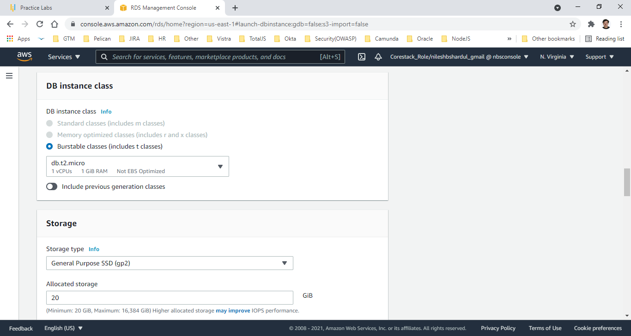
Step 9: Database instance size is t2.micro , 1 vCPU, 1 GiB RAM (as per ‘free tier’ selected, if not ‘free tier’ this could be increased)

Slide 25
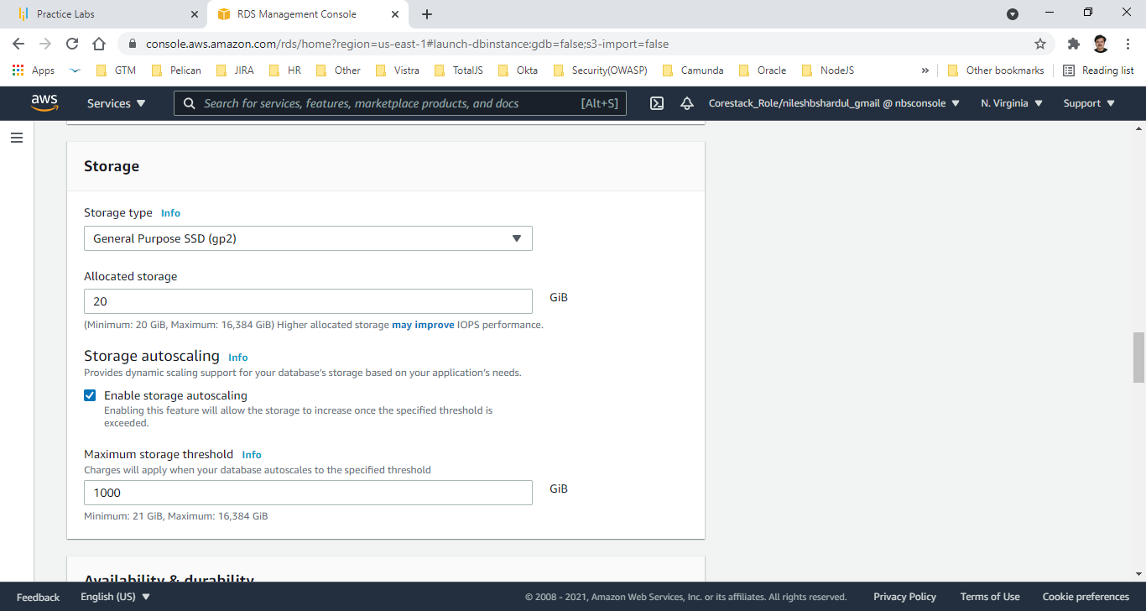
Step 10: Select General Purpose SSD with 20 GB initial size, enable auto scaling upto 1000 GB

Slide 26
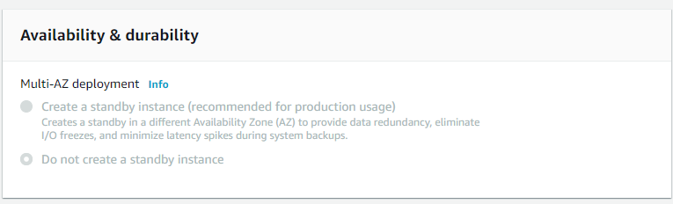
Step 11: No Multi-AZ selected (since it is a ‘free tier’) Multi-AZ is for high availability, but it has high cost.

Slide 27
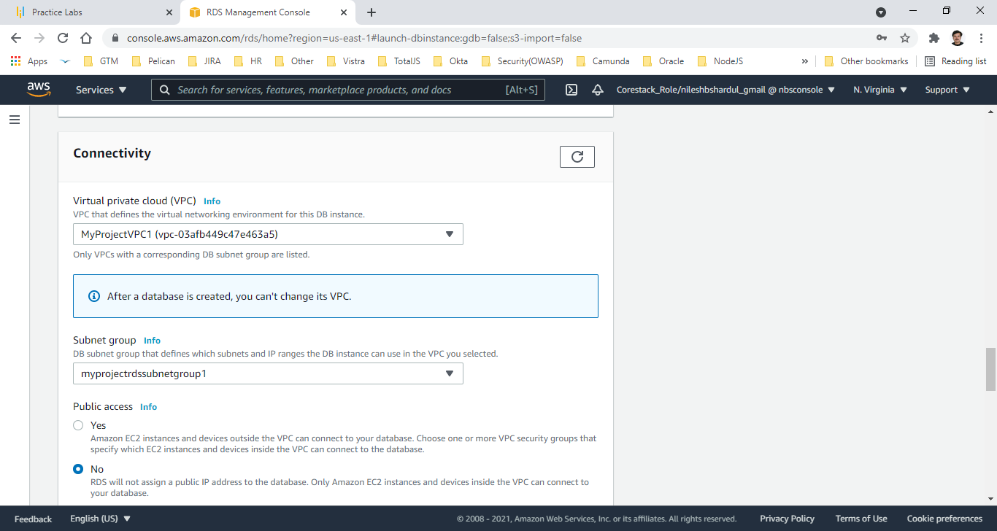
Step 12: Selected my project VPC, subnet group and no public access

Slide 28
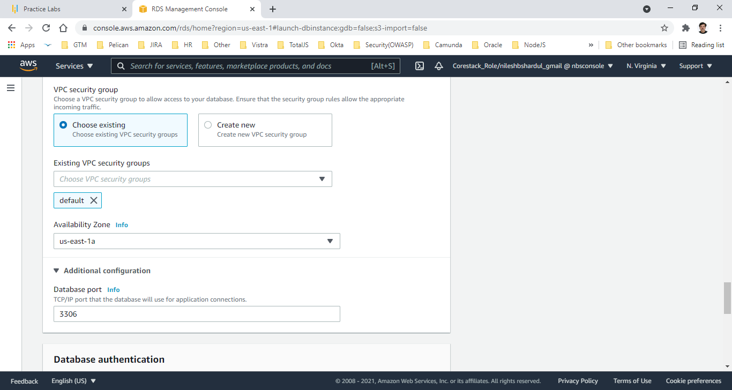
Step 13: Select existing VPC security group(default) and AZ . DB port will be -3306 which is default

Slide 29
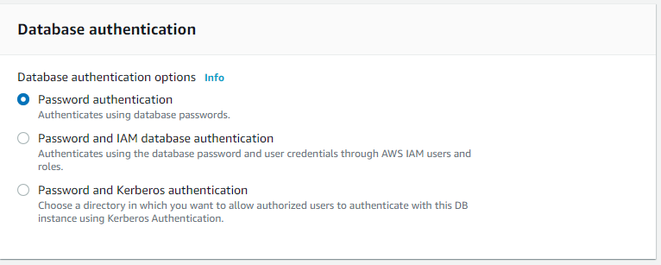
Step 14: Database authentication using Password

Slide 30
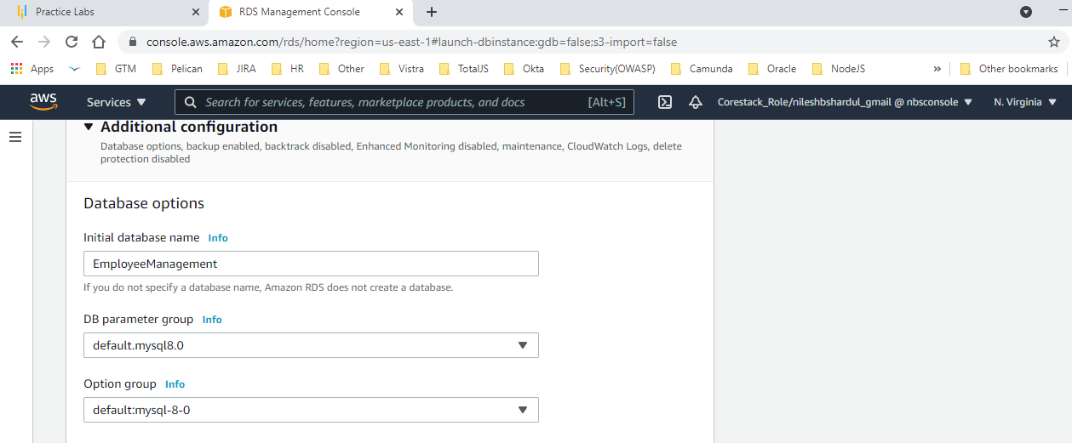
Step 15: In Additional configuration, initial DB name is EmployeeManagement

Slide 31
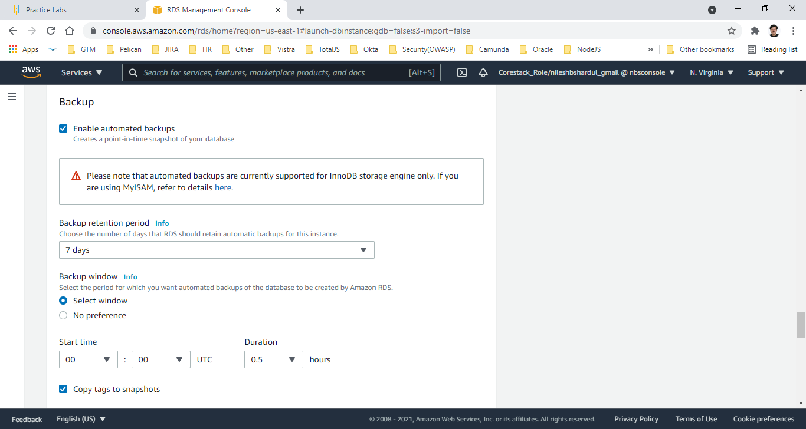
Step 16: Backup policy mentioned at day start , backup should be maintained for 7 days

Slide 32
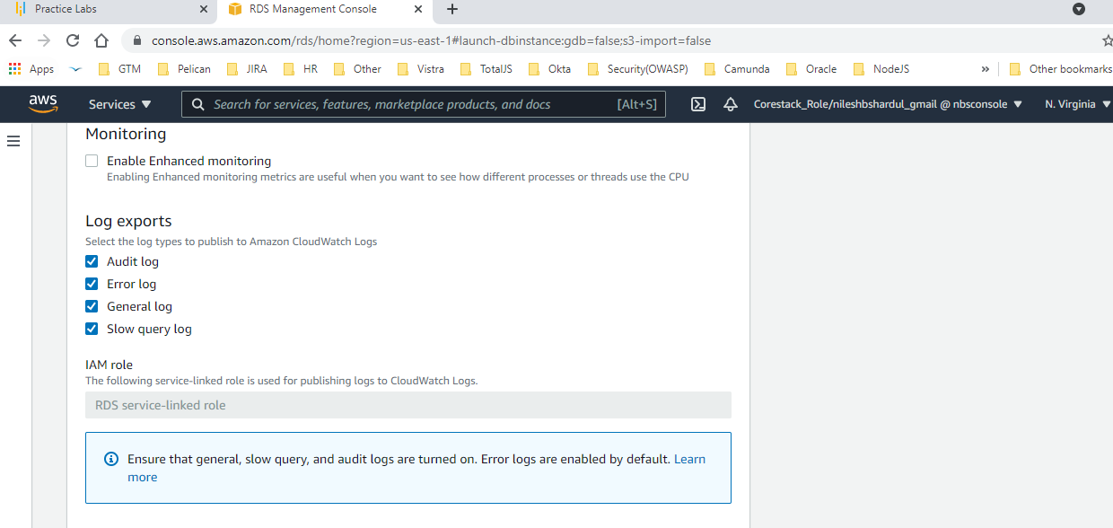
Step 17: No enhanced monitoring but select log export to CloudWatch

Slide 33
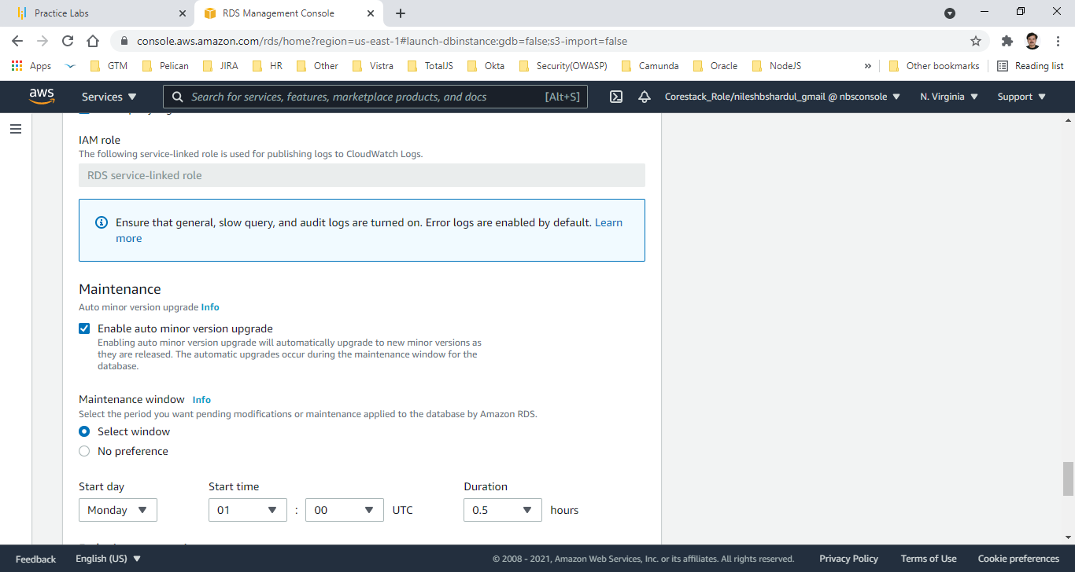
Step 18: Default IAM role for CloudWatch logs and select minor version upgrade maintenance window

Slide 34
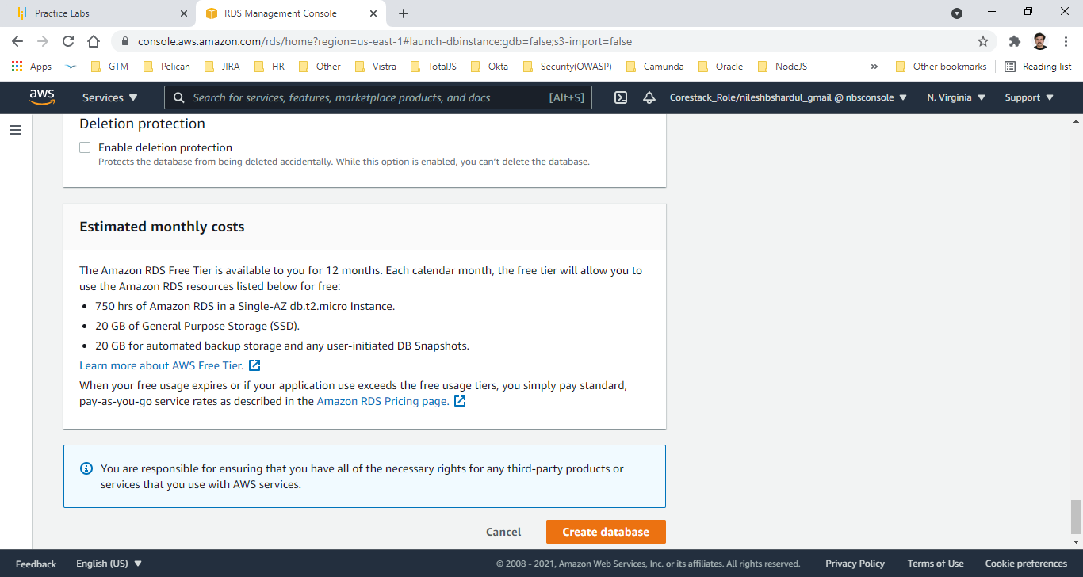
Step 19: This is estimated cost for ‘free tier’ after selecting all above options. Click on Create DB button

Slide 35
C. EC2 instance creation (Configure MySQL in Security Group)
In this, Create EC 2 instance (in free-tier) with the user data to configure Apache HTTP server and MySQL client. Add Entry for MySQL/Aurora at port 3306 in security group.
Refer the steps and screenshots below.

Slide 36
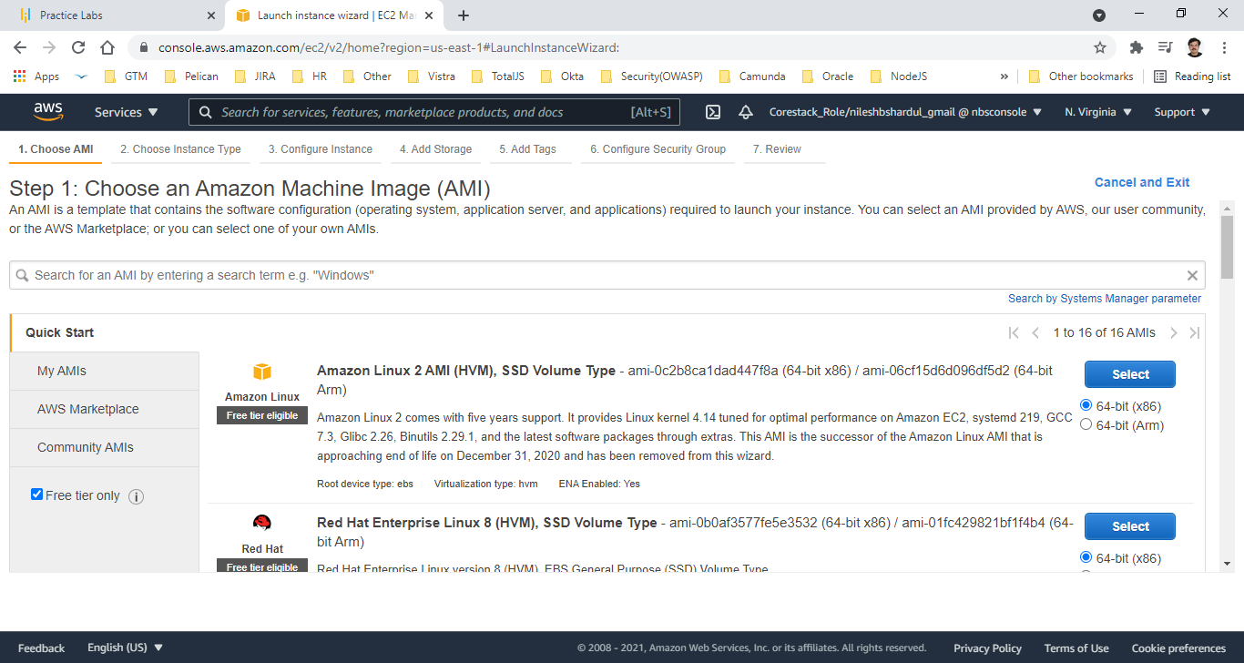
Step 1: Select Amazon Linux 2 AMI

Slide 37
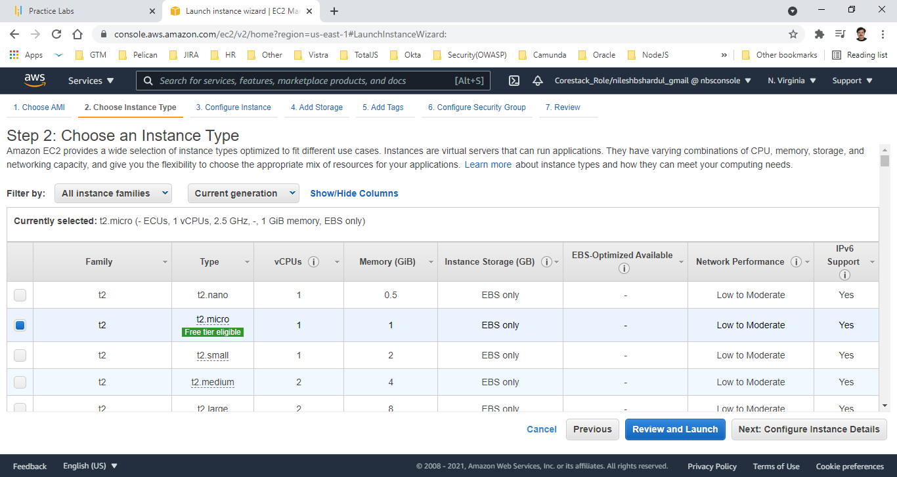
Step 2: Select instance type t2.micro

Slide 38
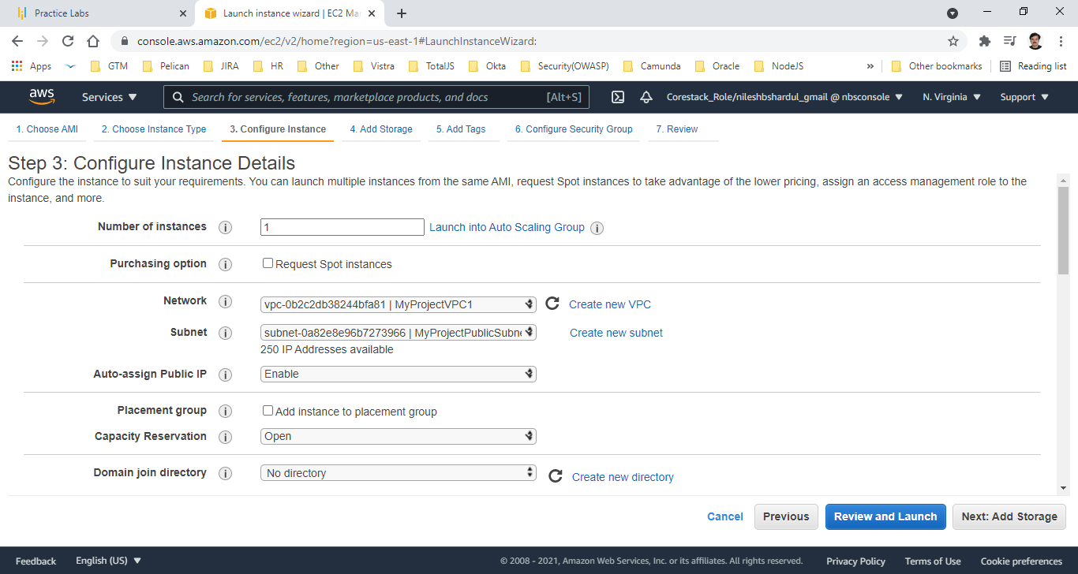
Step 3: Select Network VPC, Subnet for MyProject and Enable Auto-assign Public IP

Slide 39
Step 4: Add following lines in user data
#!/bin/bash
sudo yum update -y
sudo yum install -y httpd
sudo systemctl start httpd
sudo systemctl enable httpd
sudo chmod 0777 /var/www/html
sudo echo "<p> <b> Hostname: </b> $(hostname -f)</p>" > ./hostname_file.html
sudo yum install -y mysql

Slide 40
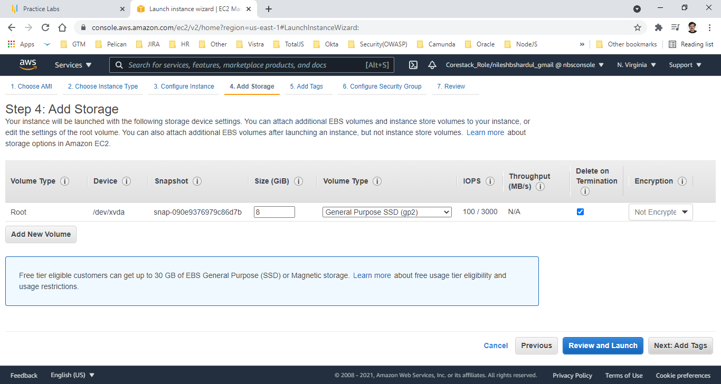
Step 5: Add storage, keep root volume size 8 GiB

Slide 41
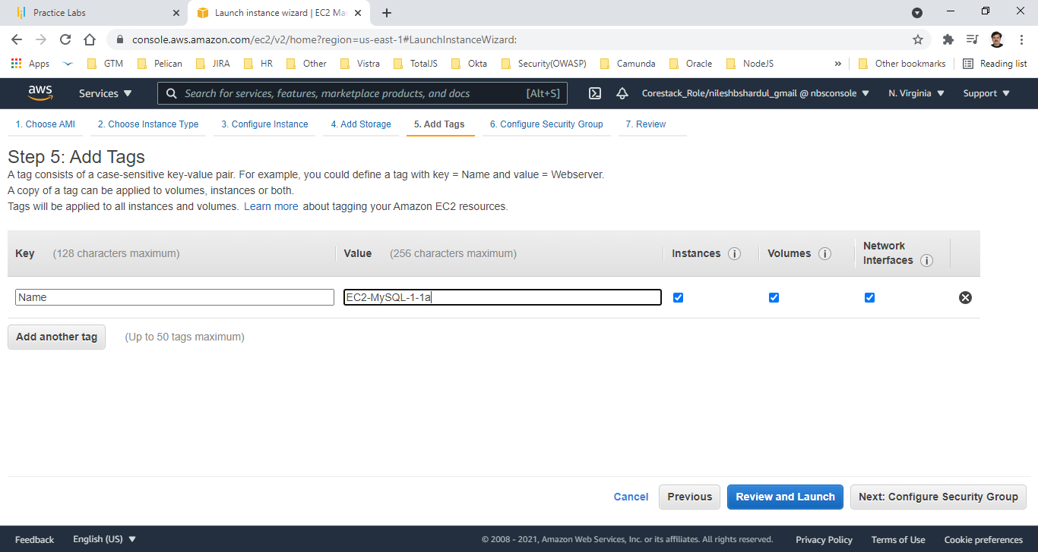
Step 6: Add name with value EC2-MySQL-1-1a in the tag

Slide 42
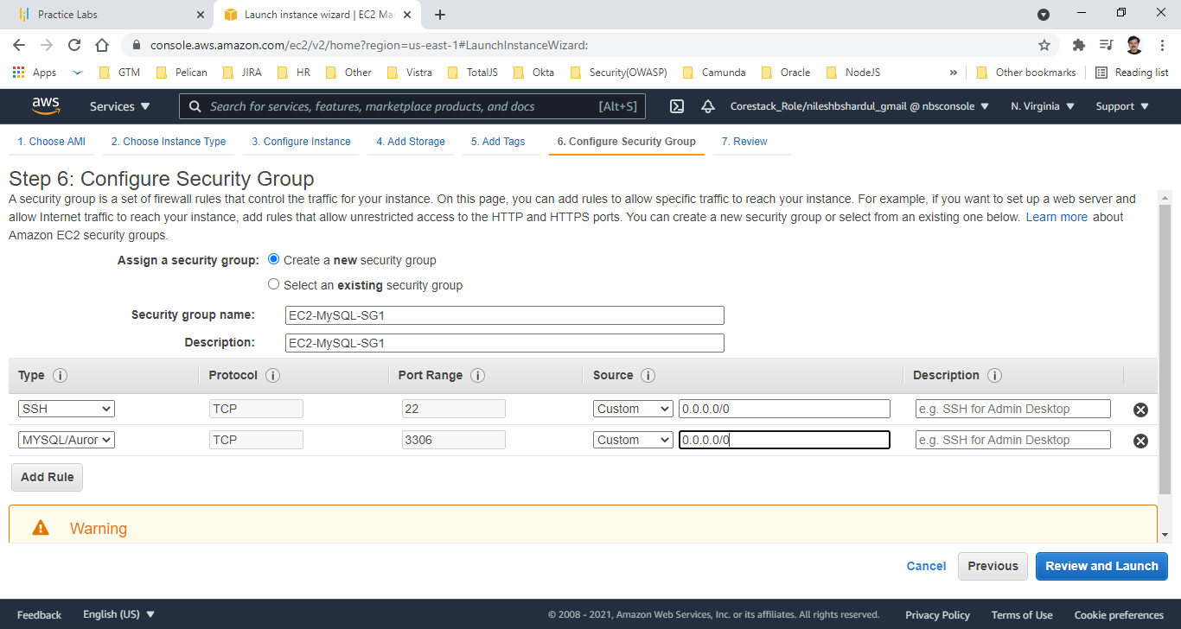
Step 7: Create new security group, add name and description- EC2-MySQL-SG1, add new rule for MySQL/Aurora for 0.0.0.0/0 (internet)

Slide 43
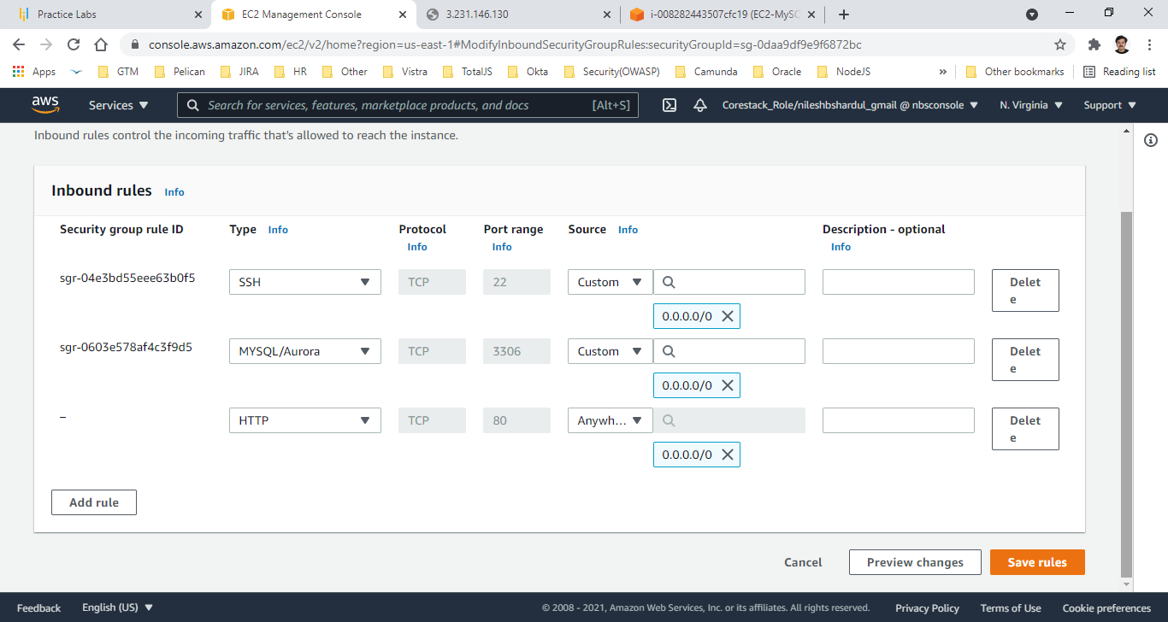
Step 8: Add port HTTP (80) for internet

Slide 44
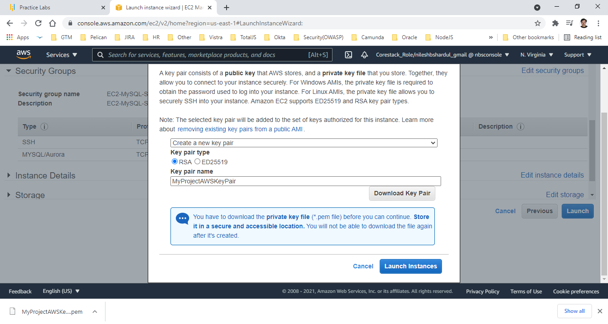
Step 9: Create new key pair named MyProjectAWSKeyPair, download and launch instances

Slide 45
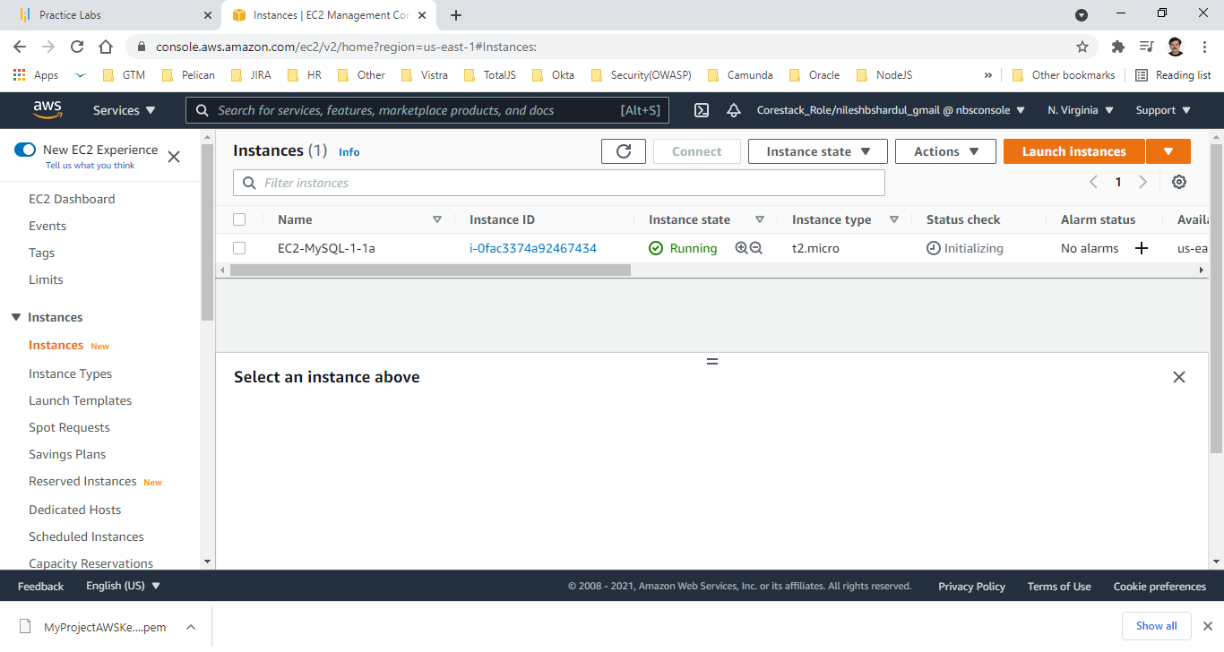
Step 10: Check Running instances

Slide 46
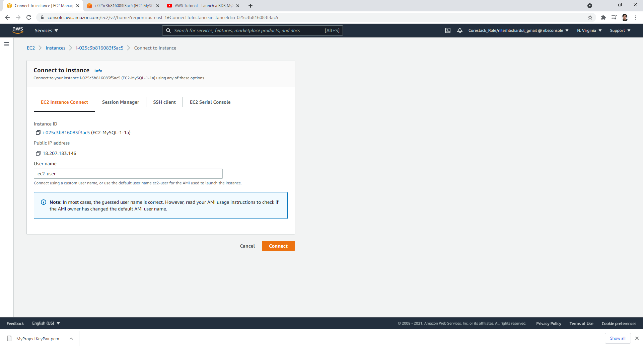
Step 11: Open instance details and connect

Slide 47
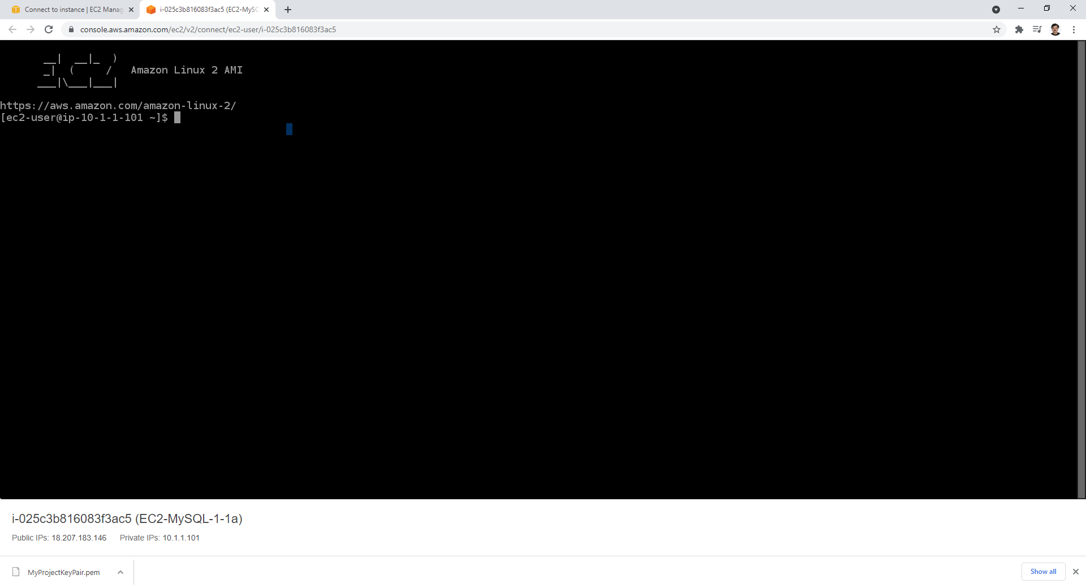
Step 12: After connecting following window will open

Slide 48
D. Configure RDS Security Group to EC2 Security Group
In RDS instance, add inbound rule for type MySQL/Aurora (port 3306) pointing to source as security group created for EC2 instances.
Please refer the steps with screenshot below.

Slide 49
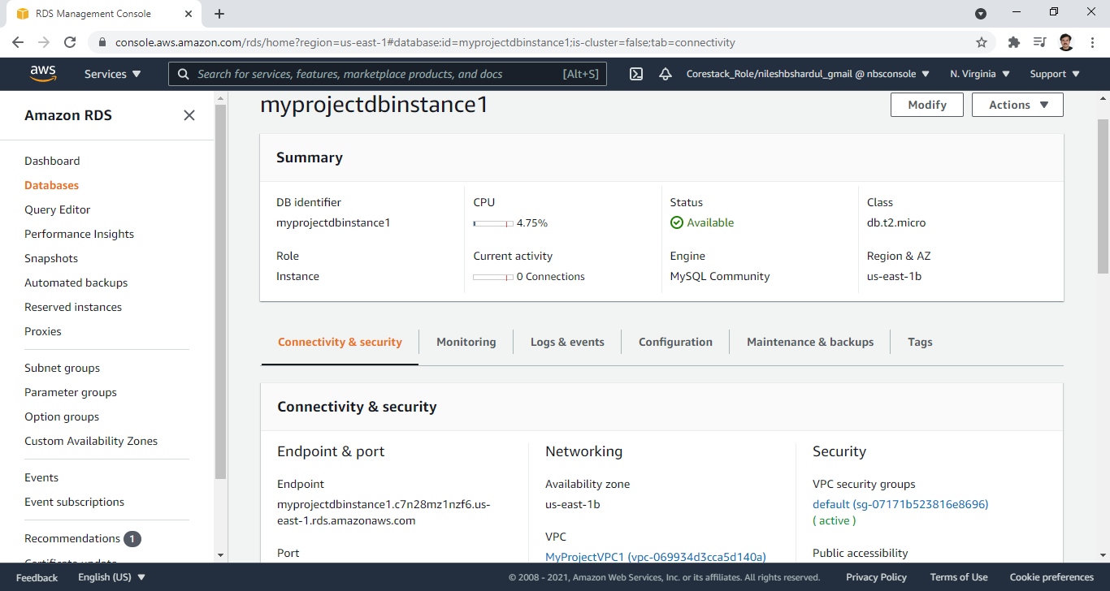
Step 1: Go to RDS instance for MyProject and Click on RDS VPC security group (active)

Slide 50
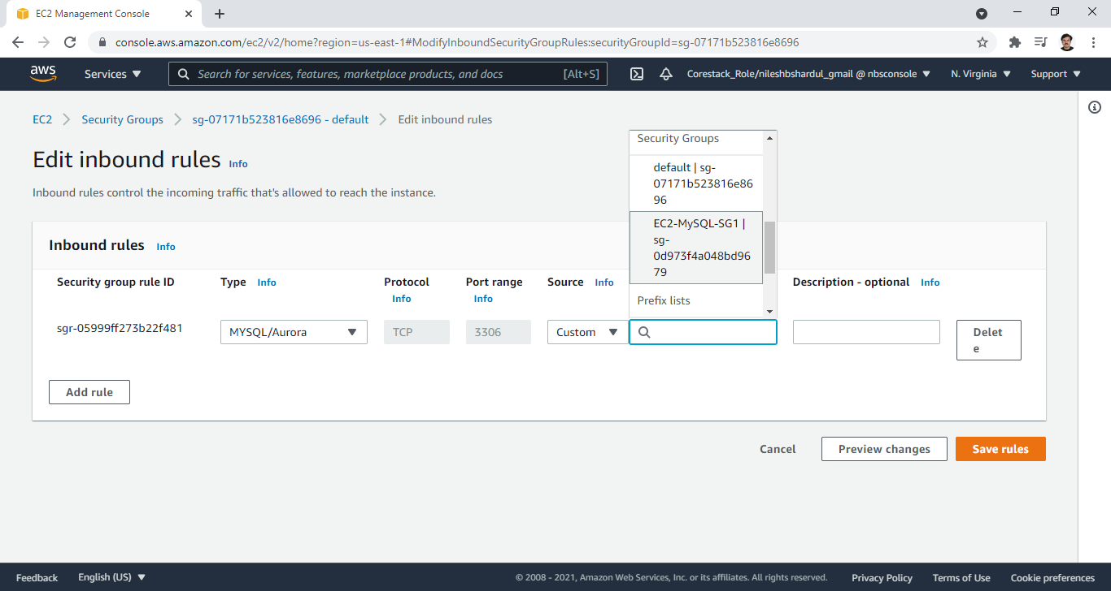
Step 2: Edit inbound rules for type MYSQL/Aurora, port 3306 add EC2-MySQL-SG1 security group which is created for EC2 instances

Slide 51
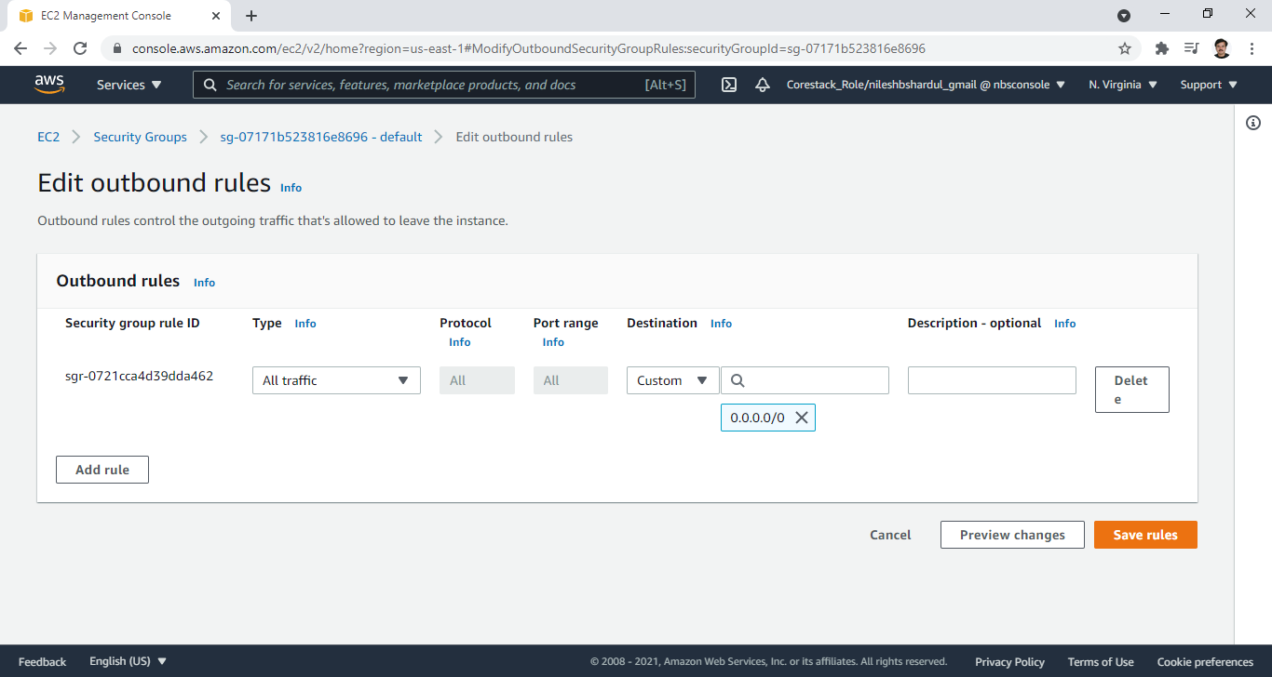
Step 3: Verify Outbound rules should be all traffic, all ports for 0.0.0.0/0 (internet)

Slide 52
Login to EC2 and test DB from MYSQL client, create tables
From EC2 connect, login to DB using MySQL client, create table and add some records to verify the connectivity from EC2.
Please refer the steps and screenshots below.

Slide 53
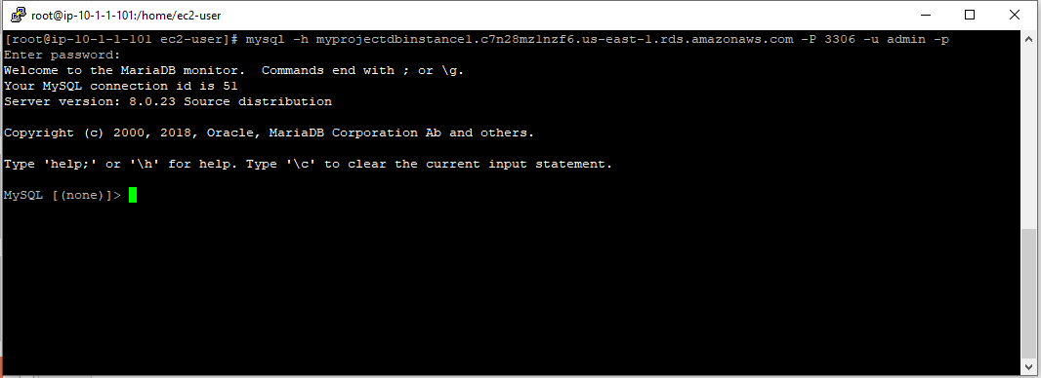
Step 1: Run command to login to MySQL > mysql –h <endpoint URL> –P 3306 –u admin –p

Slide 54
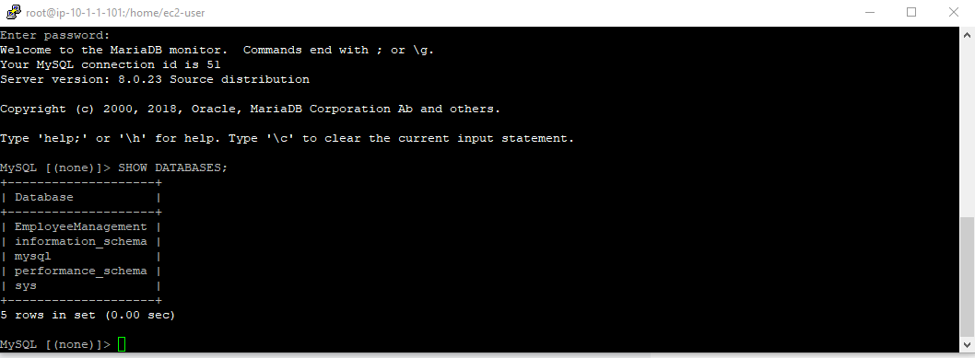
Step 2: Type following command to see the Databases. You can see the ‘EmployeeManagement’ DB created successfully which we have mentioned while creating RDS instance

Slide 55
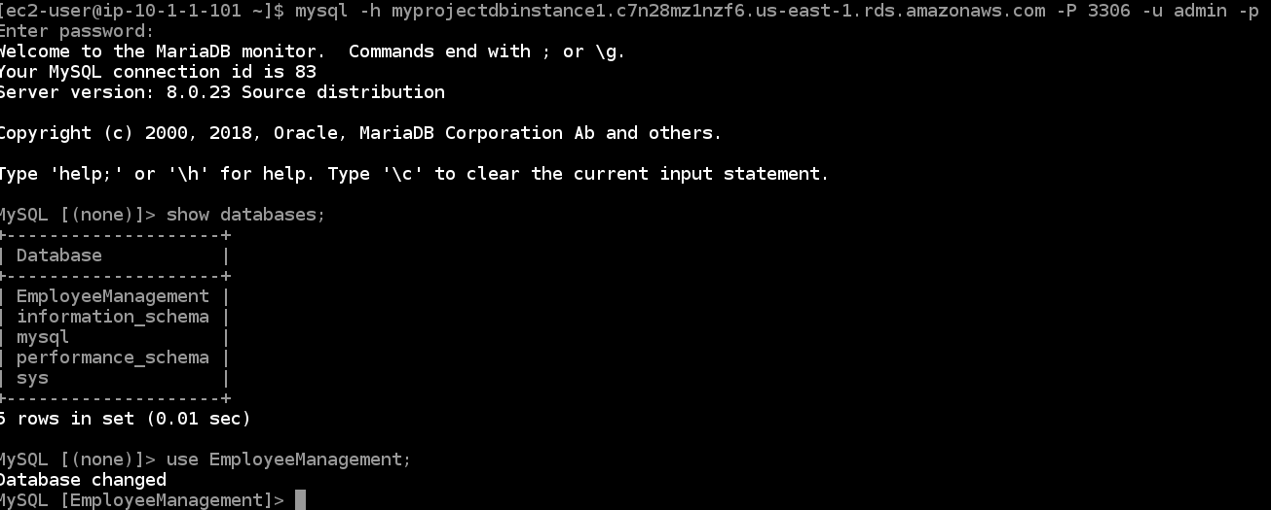
Step 3: Click following command to use the DB we want

Slide 56
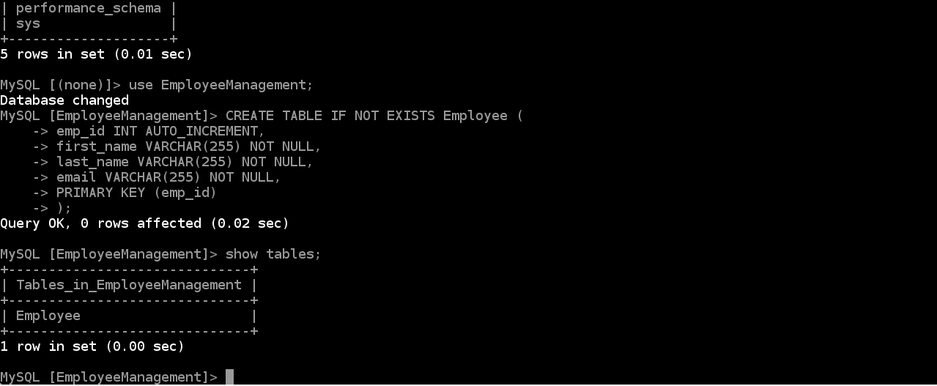
Step 4: Create table Employee and check

Slide 57
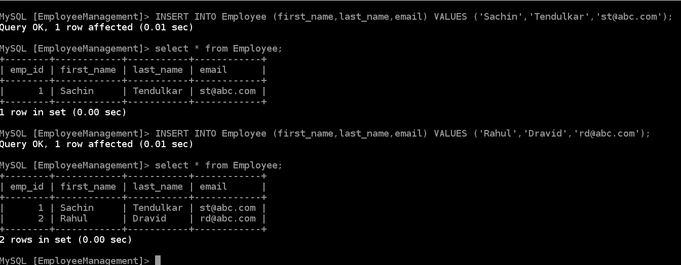
Step 5: Add and test few records shown below

Slide 58
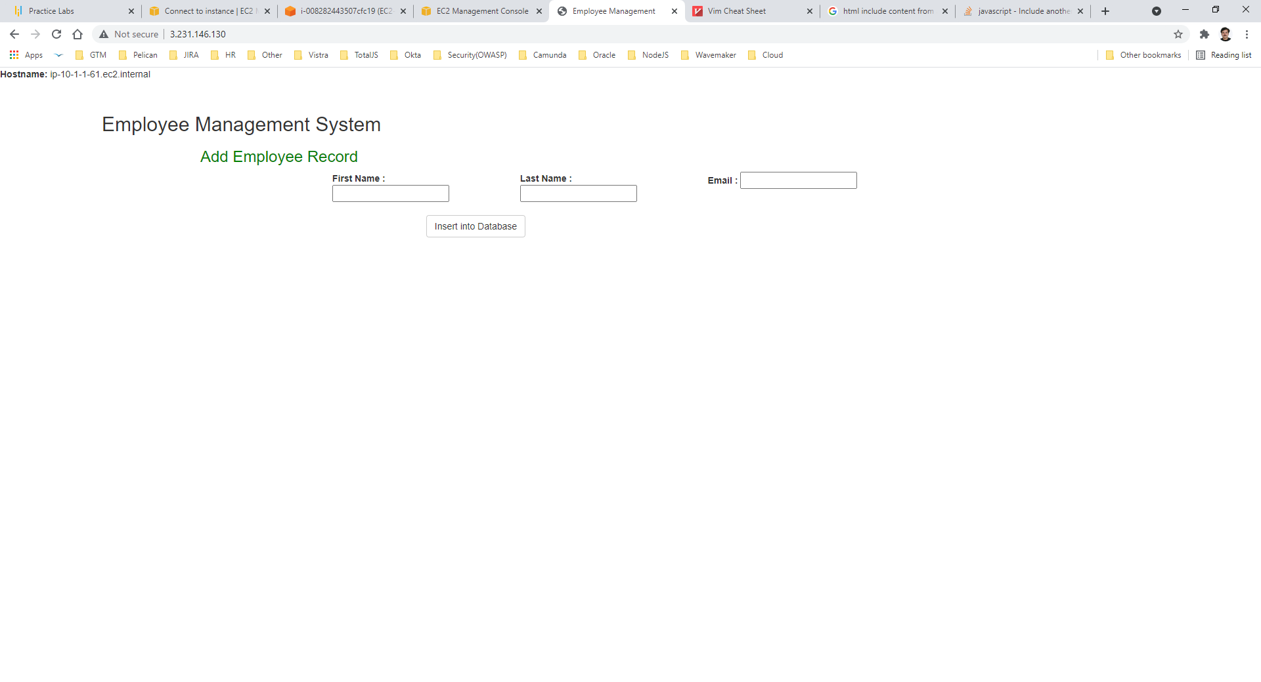
Step 6: Modify index.html file to show employee management screen. The file is available in the Project file submitted

Slide 59
F. Create new AMI and test creating new instances with the new AMI
From the created EC2 instance (which is already tested with MySQL client), create new AMI. Later create and test new EC2 instance with new AMI.
Please refer the steps and screenshots below.

Slide 60

Step 1: Create new AMI from the created instance

Slide 61

Step 2: Create image MyProject-AMI

Slide 62

Step 3: AMI is created for the EC2 instance

Slide 63

Step 4: Use the newly created AMI for new instance creation

Slide 64

Step 5: Create in AZ us-east-1b and subnet MyProjectPublicSubnet2-1b

Slide 65

Step 6: Give instance name EC2-MySQL-2-1b

Slide 66

Step 7: Select existing Security Group

Slide 67

Step 8: Choose Existing KeyPair and launch instance

Slide 68

Step 9: Verify instances started

Slide 69

Step 10: After entering public IP for second instance in browser. File index.html also got copied

Slide 70

Step 11: Also, since it created from the AMI of first instance MySQL is also got installed

Slide 71

Step 12: You can connect to DB and check tables, records etc. from this new instance

Slide 72
G. Create Load Balancer for EC2 (Load Balancer, Target Group)
Create load balancer with Target group for monitoring all the instances with health check. Also test the new domain link created by load balancer.
Please refer the steps and screenshots below.

Slide 73

Step 1: Click on Load Balancer in EC2

Slide 74

Step 2: Select application load balancer HTTP/HTTPS

Slide 75

Step 3: Create load balancer name MyProject-LB, which is internet facing, IPv4 and with the HTTP (80) protocol

Slide 76

Step 4: Select VPC and Public (since it is internet facing) Subnets created on the AZs for MyProject

Slide 77

Step 5: Click on Next in Configure Security Settings

Slide 78

Step 6: Create Security Group for load Balancer MyProject-LB-SG and allow port 80

Slide 79

Step 7: In Configure Routing create new Target Group MyProject-LB-TG with Instance type on Protocol HTTP with port 80

Slide 80

Step 8: Keep the health check on HTTP and click on Register Targets

Slide 81

Step 9: Select the running instances and click on Add to registered button. Then selected instances will be shown in the above list. Click on Review

Slide 82

Step 10: Copy DNS name created in load balancer and check the link in Browser

Slide 83

Step 11: You can see following screen after putting DNS link on the browser. Now request goes to instance deployed on us-east-1. Refresh link and check if it goes to another instance on us-east-1b

Slide 84

Step 12: Check Target group under load balancer for health check

Slide 85

Step 13: After clicking refresh, request goes to another AZ , us-east-1b

Slide 86

Step 14: You can check the Health status in Target Group

Slide 87
H. Create Auto Scaling for EC2 (Auto Scaling Group, Launch Configuration)
Create a new launch template for EC2 instance from the already created AMI. In Auto Scaling Group configure launch template, VPC, subnets. Select health check from already created Load Balancer. Also, mention min, max and designed CPU instances based on auto scaling policy
Please refer the steps and screenshots below.

Slide 88

Step 1: Create Auto Scaling Group from EC2

Slide 89

Step 2: Create auto scaling group MyProject-ASG and click on create a launch template link below

Slide 90

Step 3: In the new Launch Template wizard create template MyProject-LT

Slide 91

Step 4: Select AMI which is already created for the instance (MyProject-AMI) and instance type

Slide 92

Step 5: Select KeyPair and Security Group for of the instances which are running in my VPC

Slide 93

Step 6: You can add storage or tags if needed otherwise move down

Slide 94

Step 7: Click on create launch template. Since I have already selected MyProject-AMI, not adding anything in Advance Settings-user data

Slide 95

Step 8: Launch template is created

Slide 96

Step 9: Go back to Auto Scaling group, click on refresh button on the right of launch template and select newly create launch template. Click on next button

Slide 97

Step 10: Select MyProject VPC and subnets in Network and click on next button

Slide 98

Step 11: Select Choose from existing Target group and select MyProject target group as shown

Slide 99

Step 12: Select ELB option in Health Check and click on next button

Slide 100

Step 13: Select Desired, Minimum and Maximum capacity. Select these param values as per your choice.

Slide 101

Step 14: Select Target scaling policy on Avg. CPU utilization of 60% and 60 seconds to warm up before including the metric. Select these param values as per your choice

Slide 102

Step 16: Add notifications if required for that you need to create SNC topic and email here

Slide 103

Step 17: Create Auto Scaling on the last review tab

Slide 104

Step 18: Verify new Auto scaling group is created

Slide 105

Step 19: Check the activity history

Slide 106

Step 20: Go to instances link and refresh. You can see new instances added (name is ‘–’)

Slide 107

Step 21: Check the new instance details

Slide 108

Step 22: Try to open the link for new instance, see if it works as shown below

Slide 109
Step 23: Check Target group under load balancer for health check

